Slide 1
GALGOTIAS UNIVERSITY Department : SCSE Project Report on Online Fitness Gym As Partial Requirement For The Degree Of MASTER OF COMPUTER APPLICATION [M.C.A]
Submitted By :
Anuj Gangwar
&
Shivam
Submitted To:
Mrs Kiran Mam

Slide 2
Content:
Index
Home
Demo Exercise
Fitness program
About Us
Contact us

Slide 3
INTRODUCTION
* Gyms are become the essential part of our lives, providing best exercise and bodybuilding facilities to our society. Therefore, at the management end there are some necessary steps to maintain the records of every individual including trainer, trainees, and staff But maintaining the records on paper is very difficult So, it is necessary to have a computerized system that manages all these issues.
* Thus working on the management system for Gym Industry are the basis of our project. We have developed an automated version of the manual system, named as Gymnasium Management System. This system also provides excellent security of data at to its user.

Slide 4
PROJECT GOAL
To remove the manual or paper work in the Fitness club.
Provide a platform with interactive user interface for both customer and admin.
Save the time of both admin and customer.
Get online plans in effective manners.
To save cost of each user.
The one who cannot afford gym packages ,also get benefits by viewing different exercise , diet plan tutorials.
User friendly.

Slide 5
SOFTWARE TOOLS & TECHNIQUES
TECHNIQUES:
HTML
PHP
CSS
JavaScript
Jquery

Slide 6
MODULES
Index
Home
Demo Exercise
Fitness program
About Us
Contact us

Slide 7
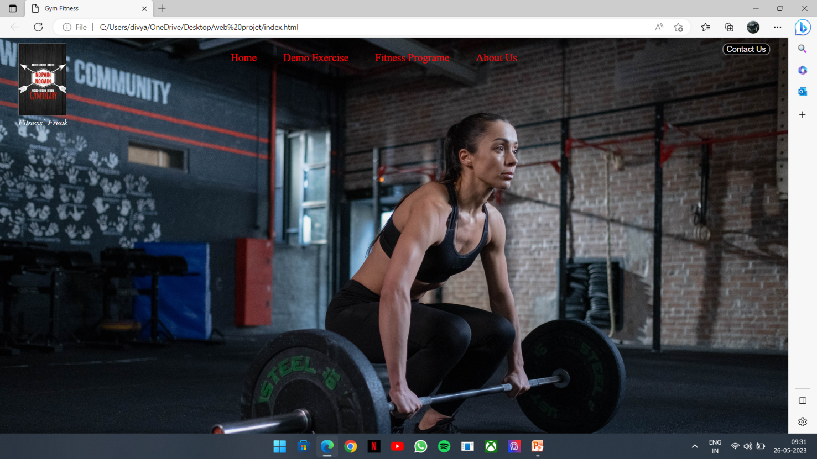
SNAPSHOTS

Slide 8
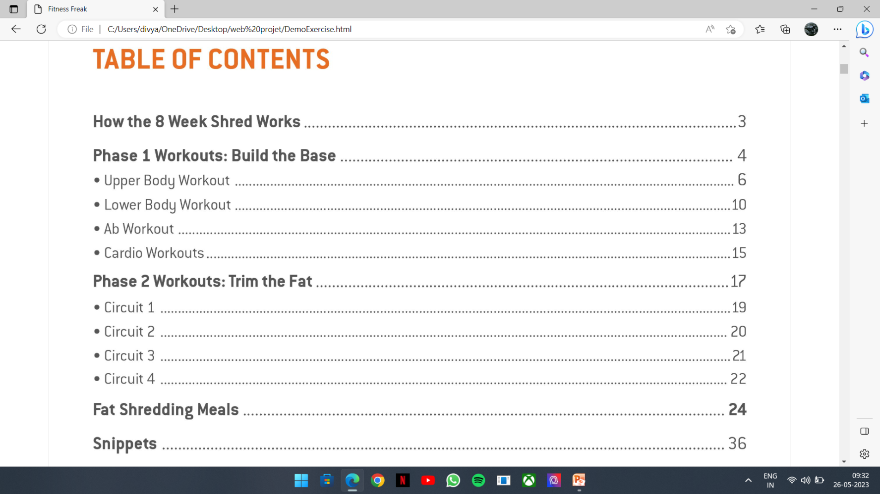

Slide 9
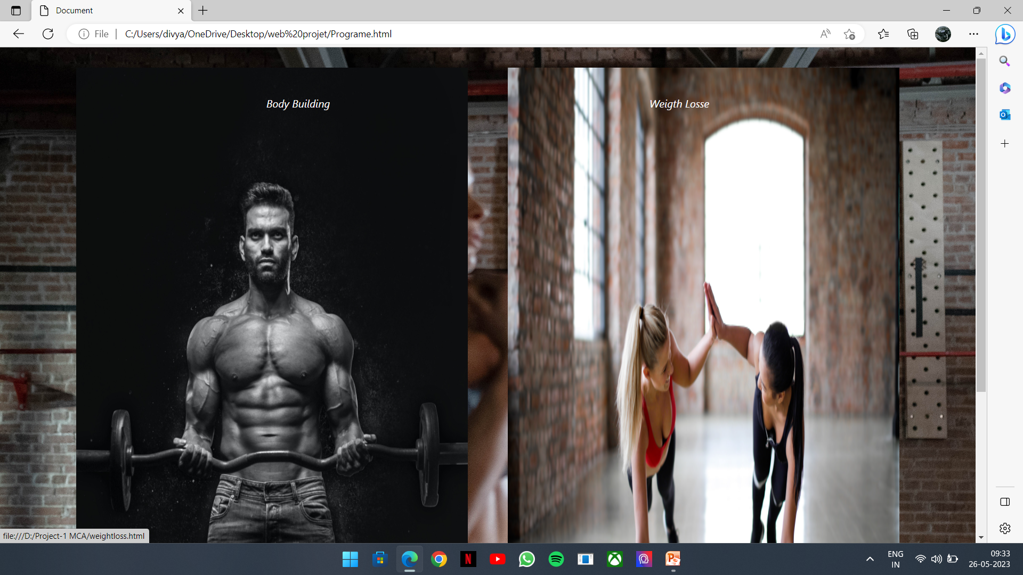

Slide 10
THANK YOU

